Slide 1
Extension activities

Slide 2
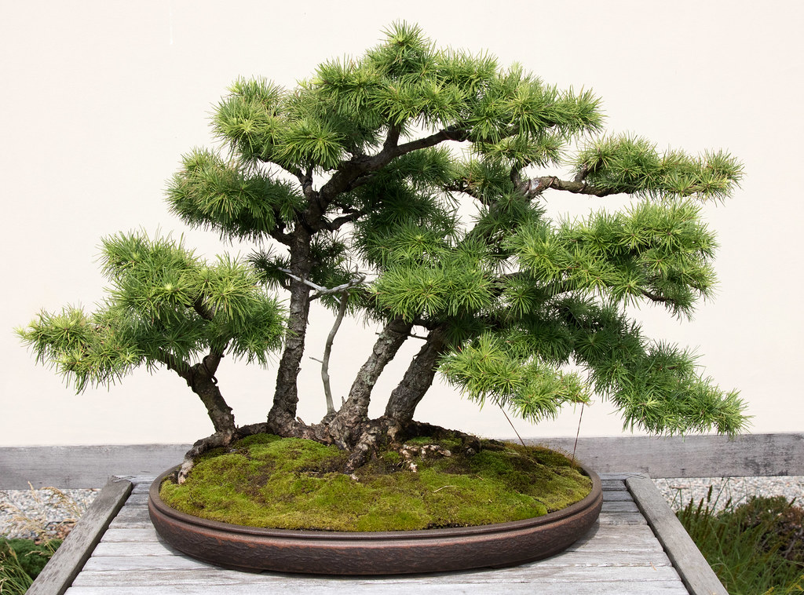
Mindful Manga
Notes:
What does ‘mindful’ mean? It means paying attention to the present moment. It is about staying in the now rather then worrying about what has happened or what will happen. Activities such as drawing can help us do this. Why do you think that is? (Discussion around concentrating and having your mind focussed on one activity. This can be relaxing and positive for our wellbeing.)
Does anyone know what kind of tree this is? Bonsai tree
Why is it special? A bonsai is a tree or shrub which is grown to look like a miniature version of a tree.
Bonsai gardening can be considered an art form.

Slide 3
Task One
Draw the outline of the tree.
Notes:
This task can be introduced the same way as the settler activity for the main lesson.
Give students only a couple of minutes and tell them to try not to lift the pencil from the paper.
For these drawing tasks you may wish to play some calming Japanese music
E.g. Piano music from Ghibli film soundtracks: https://www.youtube.com/watch?v=l43kG7iDSw8

Slide 4
Task one continued…
Add as much detail as possible to your tree.

Slide 5
Task Two
Draw the tree.
Think about
the tree as a character.
Draw a face within the branches.
Notes:
Students can redraw the tree, or this can be used as an extension for Task One.

Slide 6
Task Three
You have three minutes to look at the tree.
Now draw the tree from memory.

Slide 7
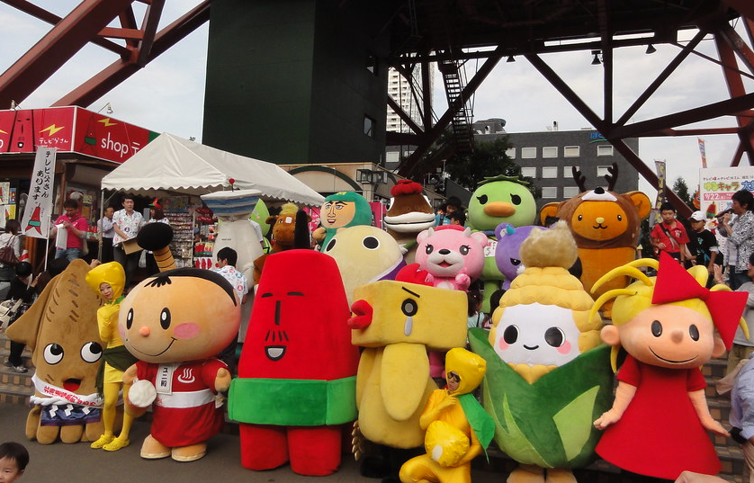
Local Mascots
Most cities and places in Japan have a mascot.
They are usually based on famous products from that place.
Click here to see more mascots
Notes:
Teacher’s Notes
Link to the main lesson by pointing out these characters are all given different human-like personalities (just like students gave to their plant manga characters.)
These characters are known as Yuru Chara and are ranked by popularity each year.
Click the link on the slide to students the top 20 characters from 2020: https://www.yurugp.jp/en/vote/result_ranking.php

Slide 8
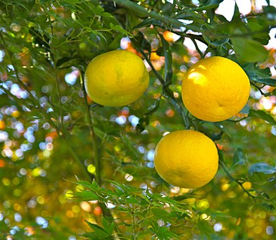
Local Mascots
This is Yuzu, a sour fruit.
Minoh is a town in a place called Osaka. It is famous for its Yuzu.
So Minoh has a mascot based on Yuzu.
Click here to meet Minoh’s mascot,
Takino-michi Yuzuru
Yuzu Oranges by Nikita from Russian Federation, is licensed under CC BY 2.0, via Wikimedia Commons

Slide 9
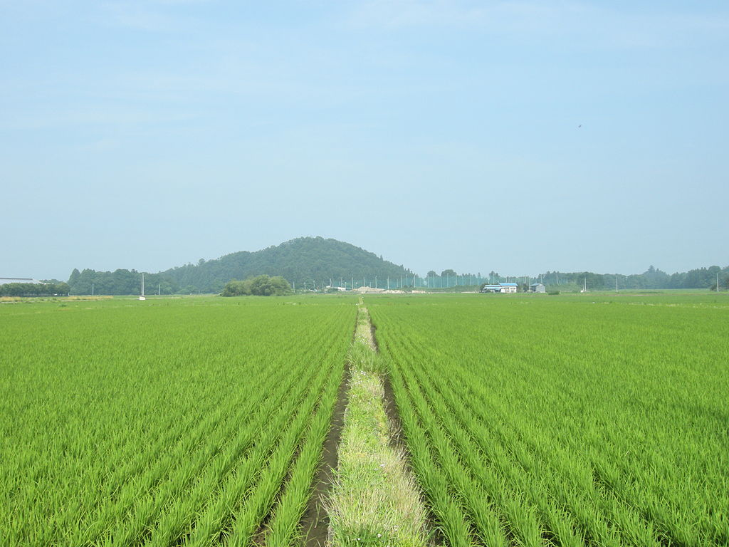
Local Mascots
This is a rice field.
It’s a common sight in many rural areas of Japan.
A town called Tako grows a lot of rice so their mascot is a ‘Rice Fairy’.
Click here to meet Tako’s mascot,
Fukura Tamako
田んぼ by contri from Yonezawa-Shi, Yamagata, Japan, CC BY-SA 2.0, via Wikimedia Commons

Slide 10
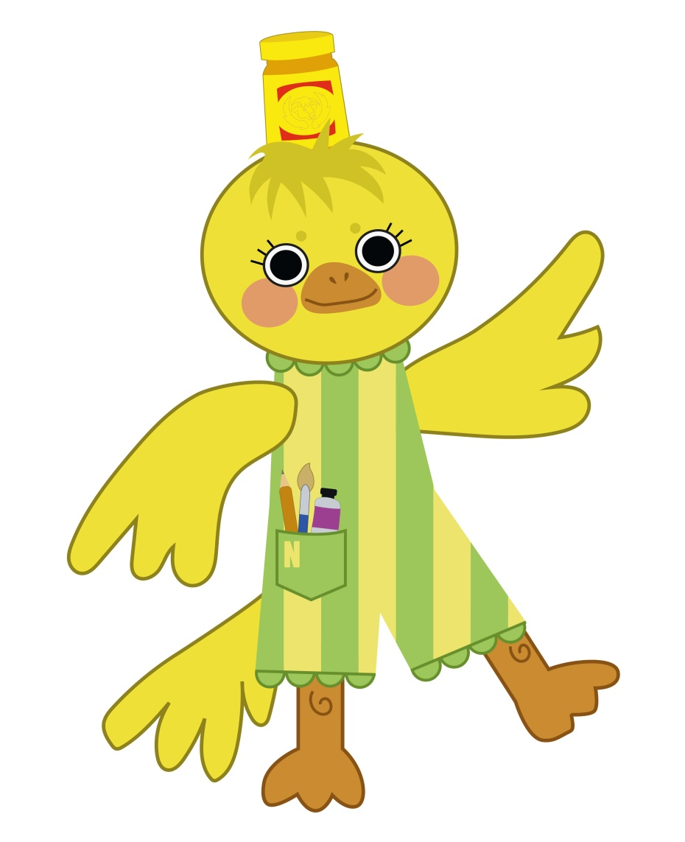
Manga Mascots
Mustard hat
Norwich is famous for mustard
Canary
The mascot for Norwich City Football Club is a canary bird
Meet Noj
Noj is an example
manga mascot for Norwich.
Noj’s personality is creative, sporty and chirpy.
Stripey suit
Represents Norwich market stalls
Art supplies University of the Arts is in Norwich
Notes:
Teacher’s Notes
As you go through each aspect of Noj, you can compare with your area and start to brainstorm with students to give them ideas for their character.

Slide 11
Design your own manga mascot!
What is your town/city famous for?
Does it make anything special?
Is there a town/city colour?
Is there a town/city symbol?
What would you like people to know about your town/city?
If your town/city had a personality, then what would it be?
© Noj illustration and design by Laura Richardson
Notes:
Teacher’s Notes
Encourage students to think about the personality of their mascot and give it an appropriate facial expression. It can be anything!

Slide 12
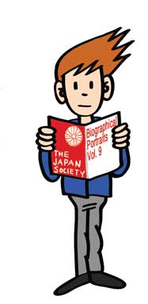
This resource is based on a workshop designed by Fumio Obata and has been adapted by Kimberley Evans in collaboration with the Japan Society.
The Japan Society 13/14 Cornwall Terrace, London NW1 4QP
Tel: 020 7935 0475
Email: education@japansociety.org.uk
www.japansociety.org.uk
Follow us on:
@japansocietylon
@JapanSocietyLondon

