Slide 2
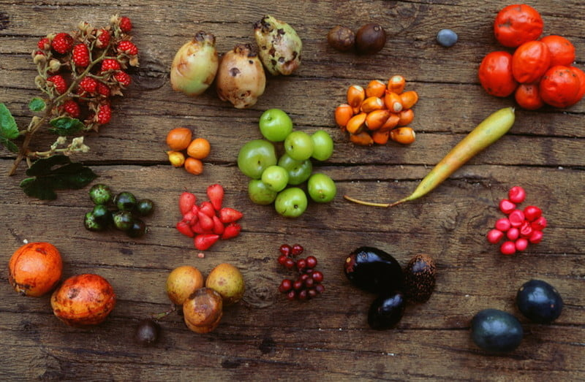
Aboriginal Australian’s have a long and storied history with the abundant natural resources found here. The culture emphasized a balance between how resources were used and respect for the land and country.
Aboriginal peoples only took what they needed and used every part of a resource. They also ensured that they caused minimal damage to the environment when collecting resources.
Food, weapons and tools, clothing, art and paintings; Aboriginal Australian used a wide range of natural resources; including mushrooms.

Slide 3
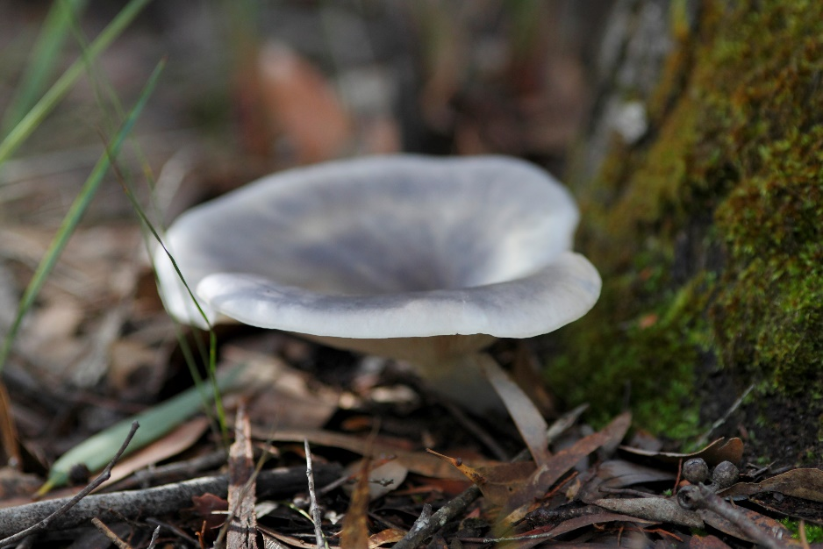
Omphalotus Nidiformis
Also known as the ‘ghost fungi’ for its pale white coloration
Bright green glow in low-light. They literally glow in the dark
But they are also toxic.
Used by aboriginal Australians for paintings and drawings.

Slide 4
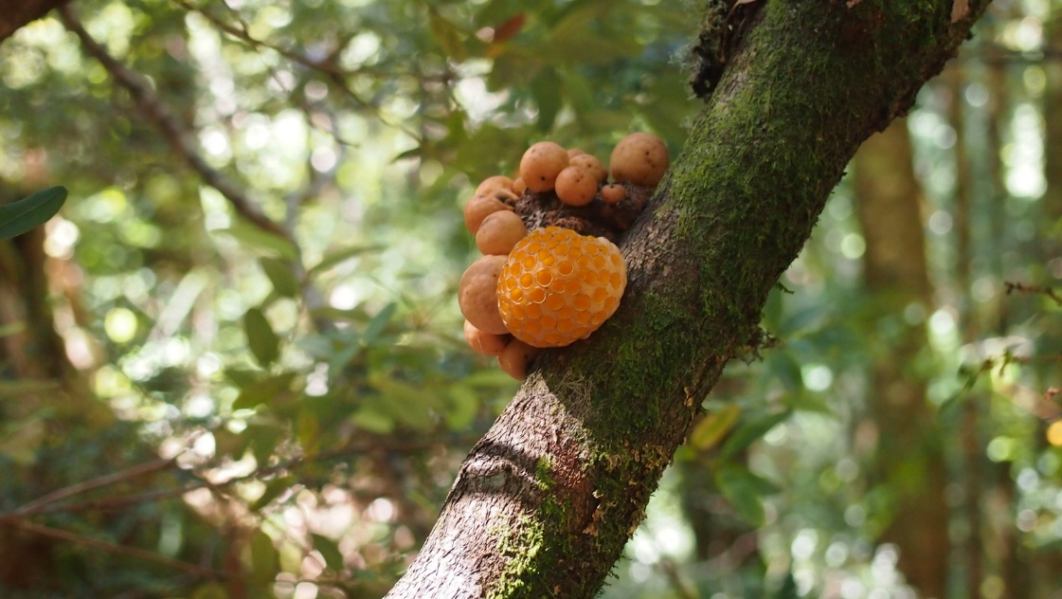
Cyttaria Gunnii
A traditional food source for Aboriginal Peoples in some areas
Contains a fluid that tastes pleasant
Only grows on Nothofagus trees in Tasmania and southern Victoria
Yellow and orange colour
Shaped like a golf ball

Slide 5
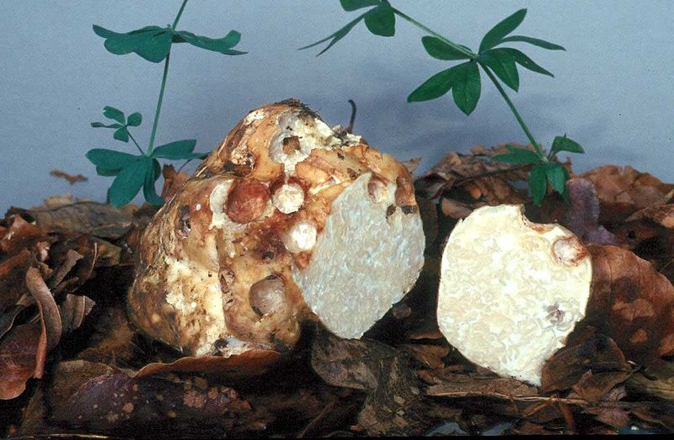
Choiromyces Aboriginum
Truffle-like fungus, traditional food source eaten raw or cooked
Used as a source of water
Grows in dry areas of Western Australia, South Australia and the Northern Territory
Cooked in hot sand and ashes for longer than one hour
Soft consistency and bland taste but reheated leftovers taste like baked cheese

Slide 6
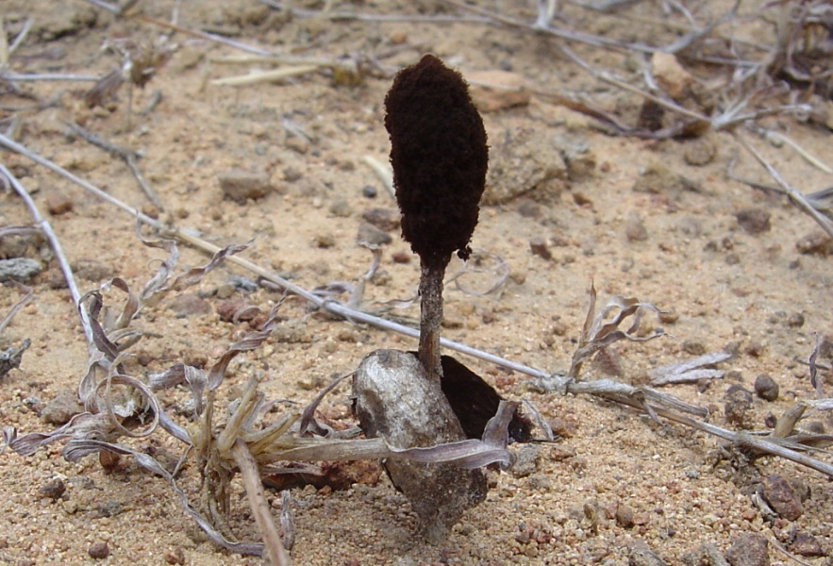
Podaxis pistillaris
Also called ‘stalked puffball’
Desert fungus used by many Aboriginal Peoples living in desert regions
Used to hide signs of aging because it would darken the white hair in elderly men's whiskers
Used for body painting
Used as a fly repellent

Slide 7
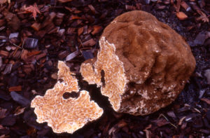
Laccocephalum mylittae
Was found by pushing a stick into the ground, which was then pulled out revealing the smell of the fungus.
Also known as native bread
Eaten raw or roasted
Tastes like boiled rice
Firm consistency
Grows underground and can grow as large as a basketball

Slide 8
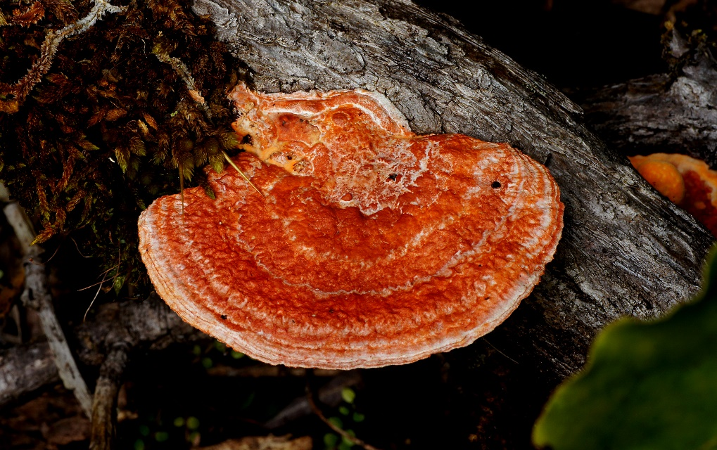
Pycnoporus sp.
Bright reddish-orange brackets, Found on dead wood
Traditionally used by desert Aboriginal people as a teething ring and for treating oral thrush in babies.
Rubbed on sore lips and sucked to help sore mouths
Contains 2 antibiotic properties used for medicine.

Slide 9
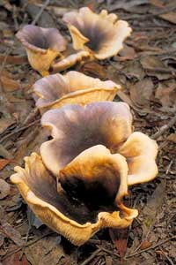
Mycoclelandia bulundari
Truffle-like fungus
Cooked in hot sand and ashes
Strong mushroom flavour
From the Northern Territory and Western Australia desert areas
Fluid used on body sores and sore eyes
Rubbed onto armpits and hair to stop it from growing

Slide 10
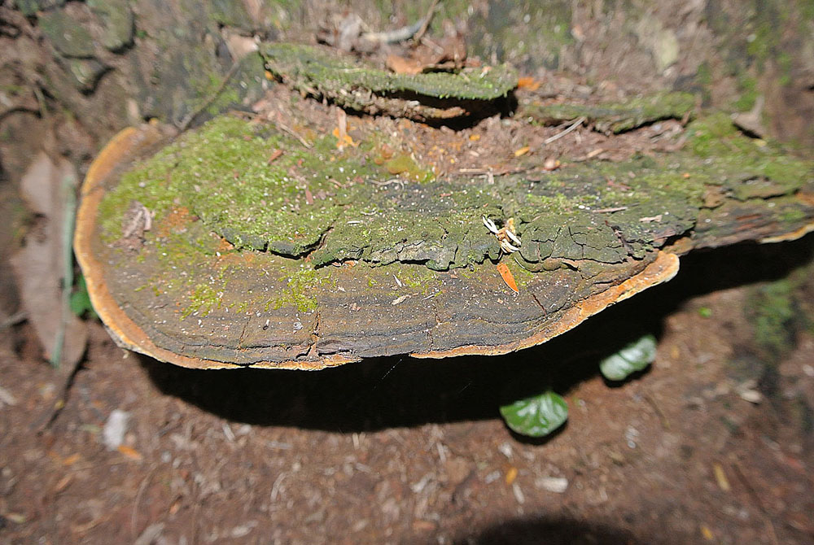
Phellinus sp.
Hard, woody bracket fungi, mostly coloured brown to black
Traditionally used as medicine, the smoke from burning them was inhaled for sore throats
Slightly burnt scrapings were mixed with water to drink as treatment for coughing, sore throats, fevers and diarrhea

Slide 11
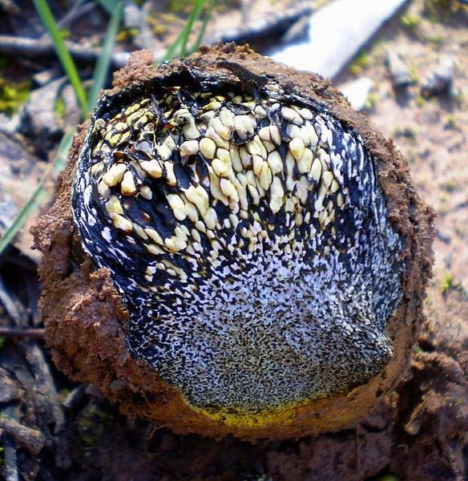
Pisolithus sp.
Traditionally eaten when the fungus was young as an emergency food
When mature it produces lots of powdery spores
Younger pisolithus have a tarry consistency that was used on wounds

